Slide 1

Learn to count it pure joy

Slide 2
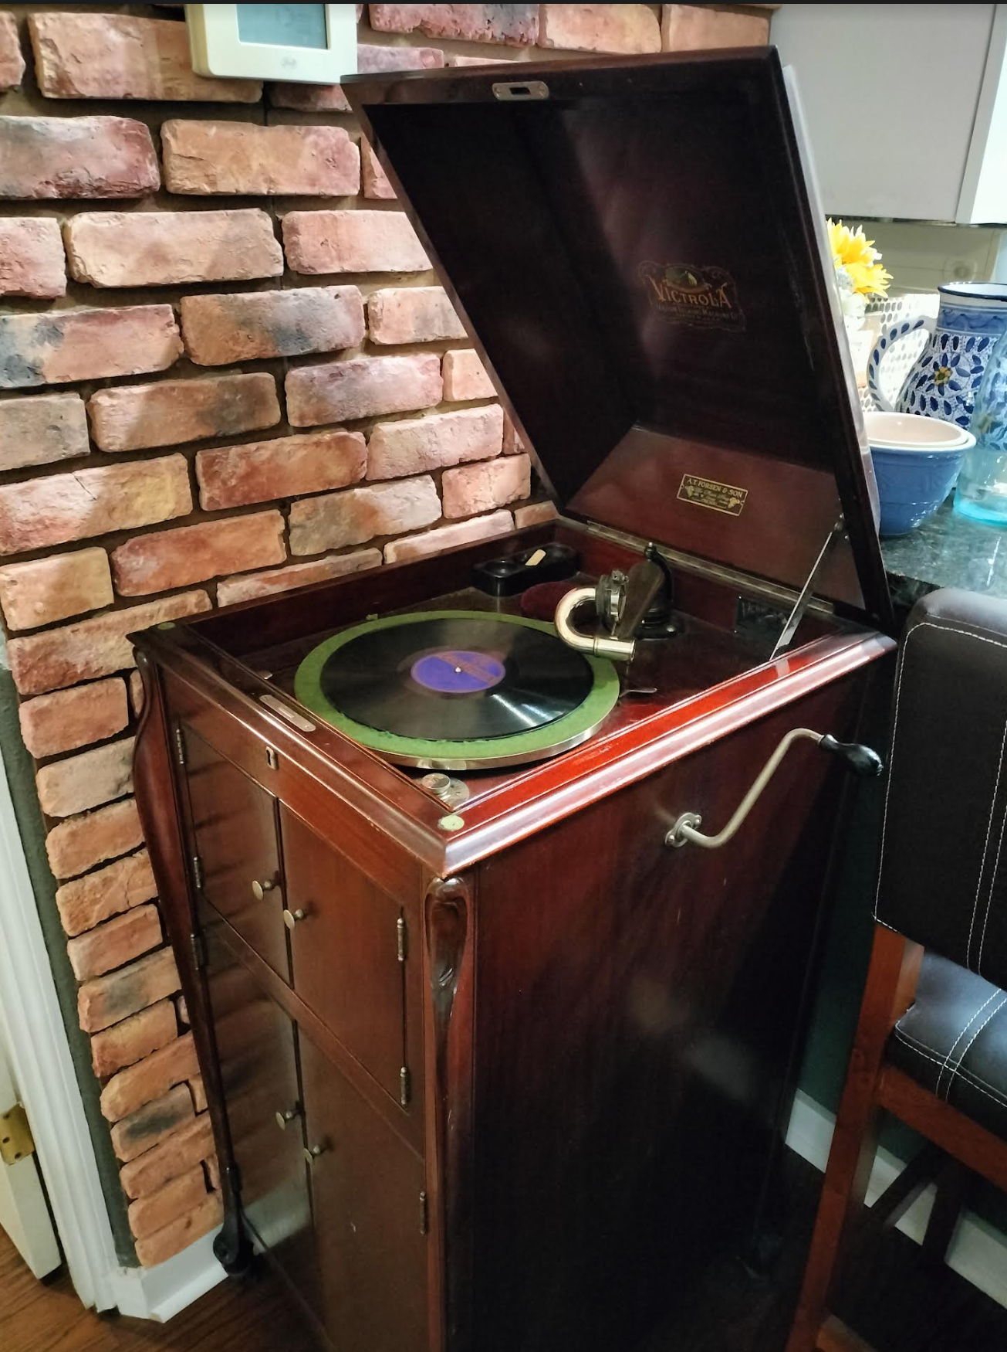
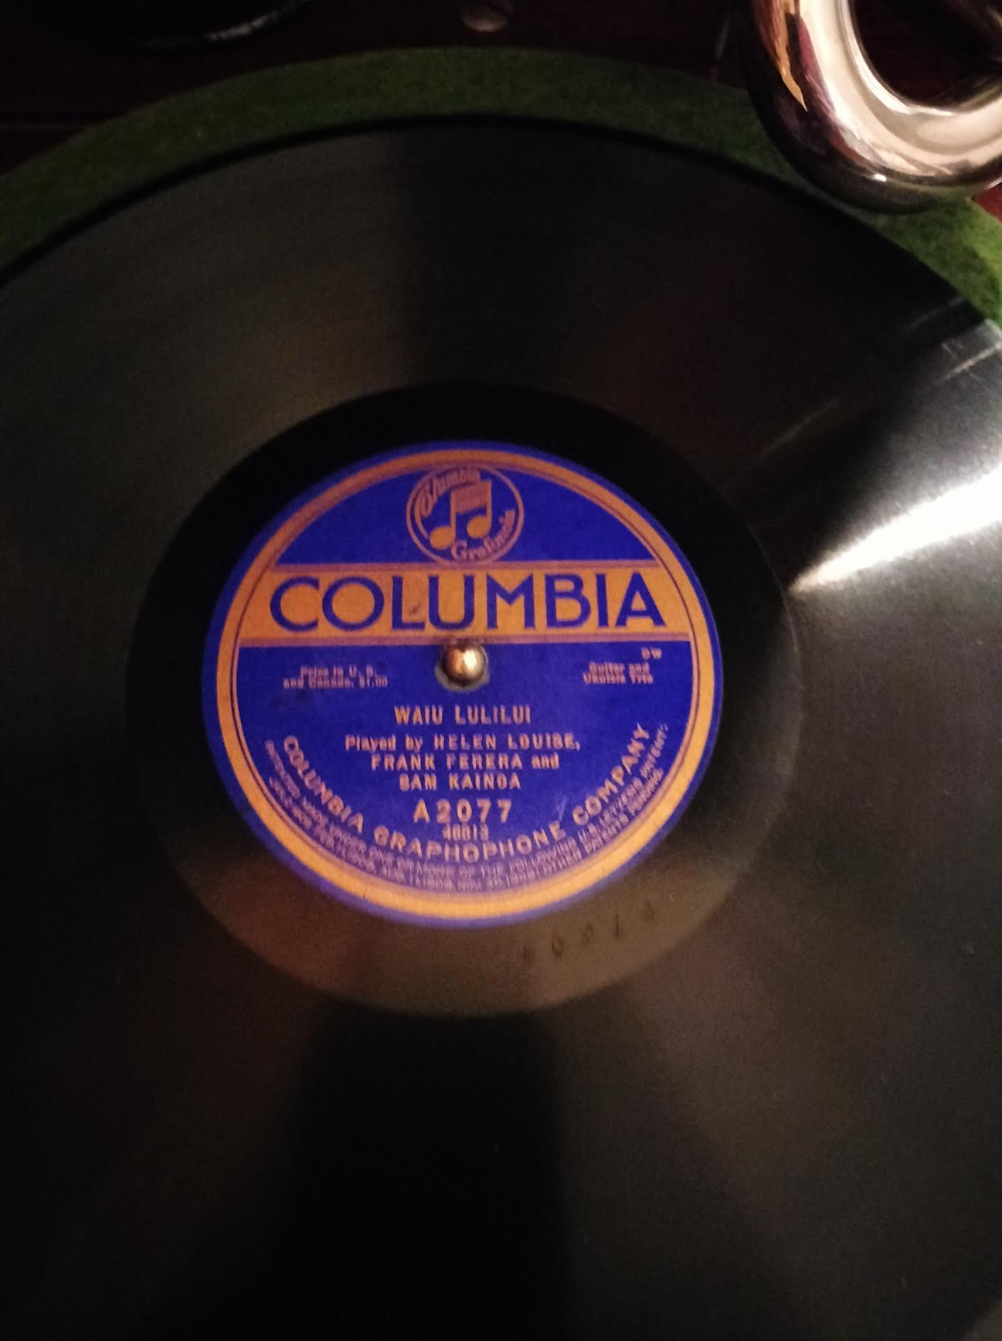

Slide 3

James 1:1-3 (ESV)
¹ James, a servant of God and of the Lord Jesus Christ, To the twelve tribes in the Dispersion: Greetings.
² Count it all joy, my brothers, when you meet trials of various kinds
³ for you know that the testing of your faith produces steadfastness.

Slide 4
In light of God’s determination to
perfect us, we need to:
• Understand his word to us.
• See God’s sovereignty.
• Learn to count.
• See God as a Father.
• See God’s work in others.

Slide 5
Understand his word to us.

Slide 6
See God’s sovereignty.

Slide 7
Learn to count.

Slide 8
See God as a Father.

Slide 9
See God’s work in others.

